Slide 1
Community Health Workers
and COVID-19
www.mhpsalud.org

Slide 2
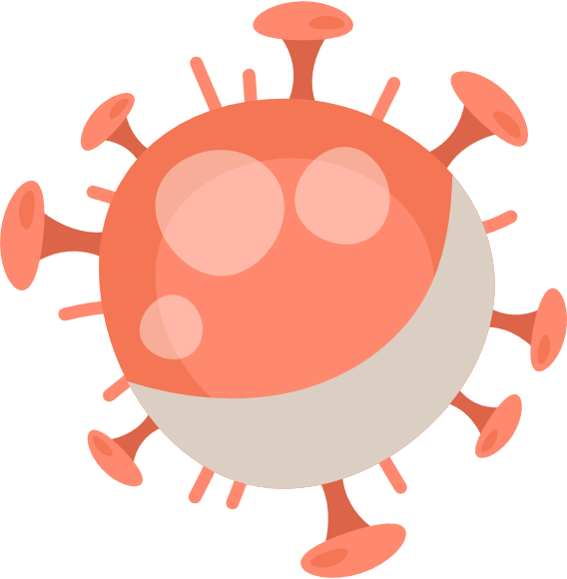
What is COVID-19?
According to the World Health Organization (WHO):
Coronavirus disease (COVID-19) is an infectious disease caused by a newly discovered coronavirus
Most people infected will experience mild to moderate respiratory illness and recover without requiring special treatment
Older people, and those with underlying medical problems like cardiovascular disease, diabetes, chronic respiratory disease, and cancer are more likely to develop serious illness
It spreads primarily from person-to-person through droplets of saliva or discharge from the nose when an infected person coughs or sneezes
https://www.who.int/health-topics/coronavirus#tab=tab_1

Slide 3
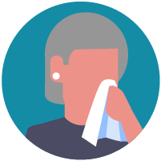
COVID-19 Preventive Measures
Steps to Protect Yourself and Others from Infection:
Wash your hands regularly with soap and water, or clean them with alcohol-based hand rub Avoid contact with people who are sick
Do not touch your face
Stay home if you feel sick and contact your medical provider
If you are sick, wear a facemask when you are around others
Cough or sneeze into your elbow
Clean and disinfect frequently touched surfaces
Refrain from smoking and other activities that weaken the lungs
Practice physical distancing by avoiding unnecessary travel and staying away from large gatherings of people
https://www.cdc.gov/coronavirus/2019-ncov/prepare/prevention.html

Slide 4
Who is at Higher Risk?
People aged 65 years of age or older
People who live in a nursing home or long-term care facility
Other high-risk conditions could include:
People with chronic lung disease or moderate to severe asthma
People who have serious heart conditions
People who are immunocompromised including cancer treatment, smoking, bone marrow or organ transplantation, poorly controlled HIV or AIDS
People of any age with severe obesity (body mass index [BMI] >40) or certain underlying medical conditions, particularly if not well controlled, such as those with diabetes, renal failure, or liver disease
Pregnant women should be monitored since they are known to be at risk with severe viral illness, however, to date data on COVID-19 has not shown increased risk
https://www.cdc.gov/coronavirus/2019-ncov/specific-groups/people-at-higher-risk.html

Slide 5
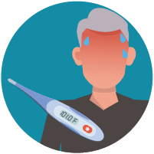
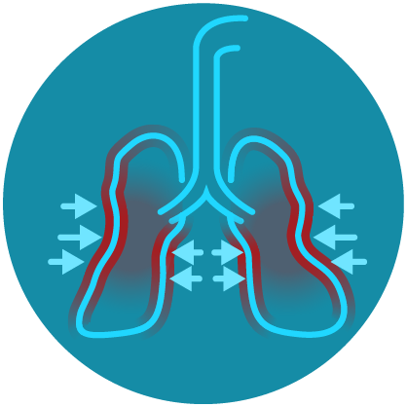
Symptoms
These symptoms may appear 2-14 days after exposure (based on the incubation period of MERS-CoV viruses).
Fever
Cough
Shortness of breath
https://www.cdc.gov/coronavirus/2019-ncov/symptoms-testing/symptoms.html

Slide 6
Community Challenges Faced with COVID-19
Fear of accessing services (due to Public Charge)
Fear of accessing services (due to immigration status)
Self-medication and self-diagnosis (due to lack of health insurance)
Lack of health information available in their language and literacy level (due to information only available in one language English)
Lack of effective communication with Health Providers (due to language barriers)
Misinformation (due to word of mouth and false news)
Fewer local resources available such as food banks and shelters (due to overuse caused by panic)
Fewer medical resources and long wait times (due local clinics/hospitals applying restrictions and giving priority to COVID-19 response efforts)
Lack of transportation (due to limitation and restriction applied as COVID-19 response)
Unavoidable exposure to COVID-19 risk (due to “essential” job requirements)

Slide 7
Community Health Workers (CHWs)
A CHW is a frontline public health worker who is a trusted member of and/or has an unusually close understanding of the community served. This trusting relationship enables the worker to serve as a liaison/link/intermediary between health and social services and the community to facilitate access to services and improve the quality and cultural competence of service delivery.
Therefore, they are uniquely equipped to help the community cope with challenges faced due to COVID-19
https://www.apha.org/apha-communities/member-sections/community-health-workers

Slide 8
CHWs Unique Response to COVID-19
COVID-19 Challenges | CHWs Unique Response
Fear of accessing services (due to Public Charge) | CHWs can assist with clarifying Public Charge myths by using reliable resources to clear doubts
Fear of accessing services (due to immigration status) | CHWs can assist with clarifying immigration myths and make referrals to community agencies that could offer assistance
Self-medication and self-diagnosis (due to lack of health insurance) | CHWs can offer assistance to help consumers to apply health insurance
Lack of health information available in their language and literacy level (due to information only available in one language English) | CHWs can assist with the translation of documents and information
Lack of effective communication with health providers (due to language barriers) | CHWs can act as intermediary between patient-health provider and health provider-patient communication

Slide 9
CHWs Unique Response to COVID-19
COVID-19 Challenges | CHWs Unique Response
Misinformation (due to word of mouth and false news) | CHWs can help direct the community to credible and reliable sources for news, local information, and resources
Fewer local resources available such as food banks and shelters (due to overuse caused by panic) | CHWs can direct community members to available local resources
Fewer medical resources and long wait times (due local clinics/hospitals applying restrictions and giving priority to COVID-19 response efforts) | CHWs can direct community members to available local medical resources
Lack of transportation (due to limitation and restriction applied as COVID-19 response) | CHWs can direct community members to available local transportation resources
Unavoidable exposure to COVID-19 risk (do to “essential” job requirements) | CHWs can provide education on how to minimize risk

Slide 10
Questions?

Slide 11
www.mhpsalud.org

